Slide 1
Gravity Books Data Warehouse Design.

Slide 2
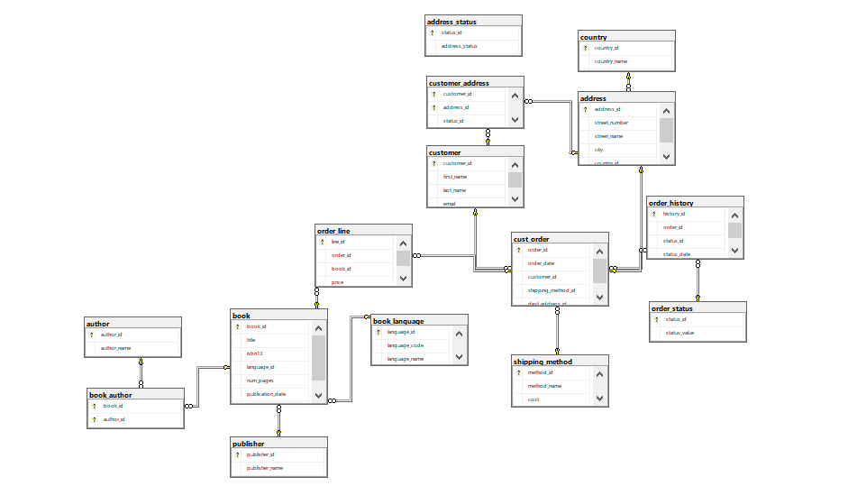
Gravity Book )OLTB( scheme

Slide 3
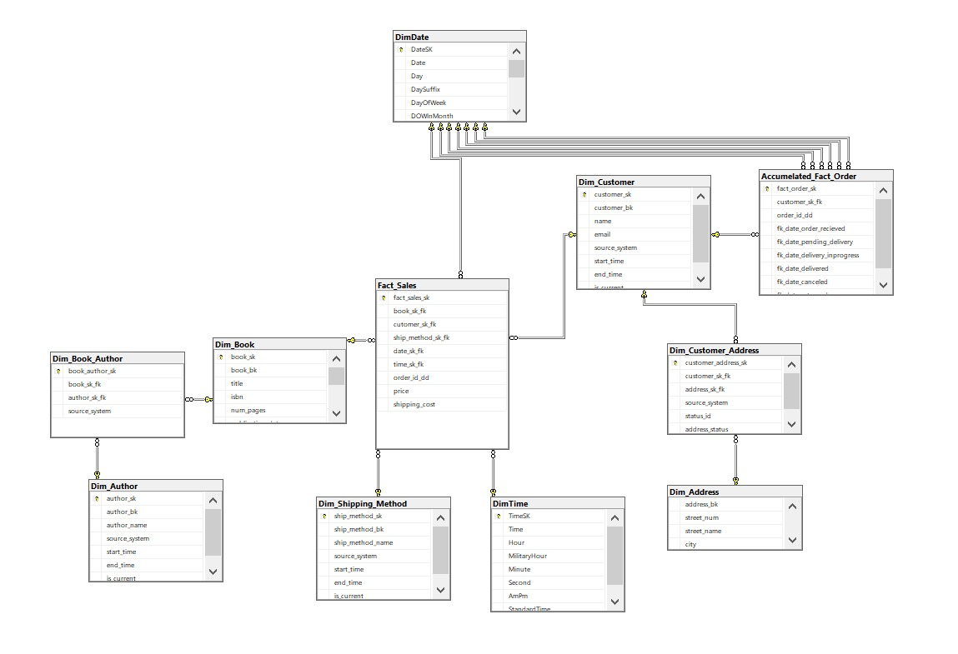
Dimensional Modeling Design (OLAB)

Slide 4
SQL Server Integration Services (SSIS)
ETL Process

Slide 5
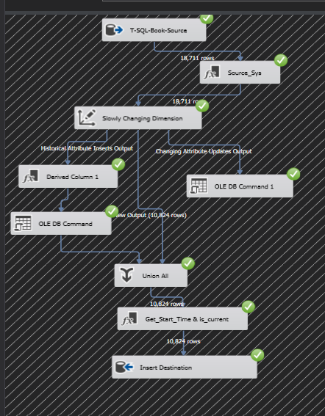
Book_Dim

Slide 6
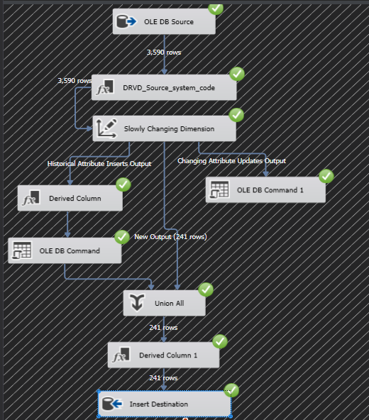
Customer_Dim

Slide 7
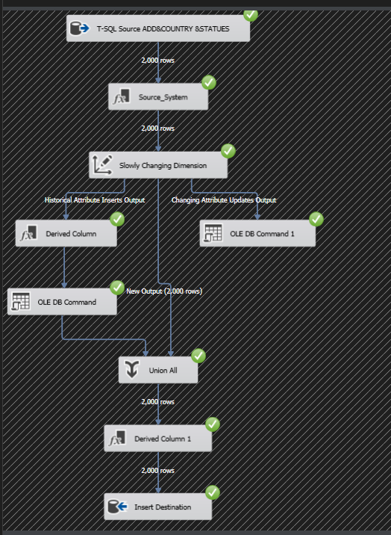
Address_Dim

Slide 8
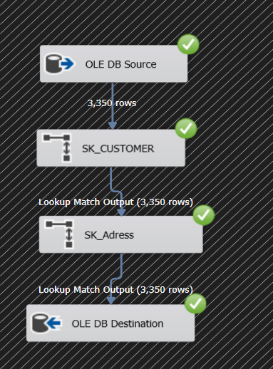
Customer-Address_Dim

Slide 9
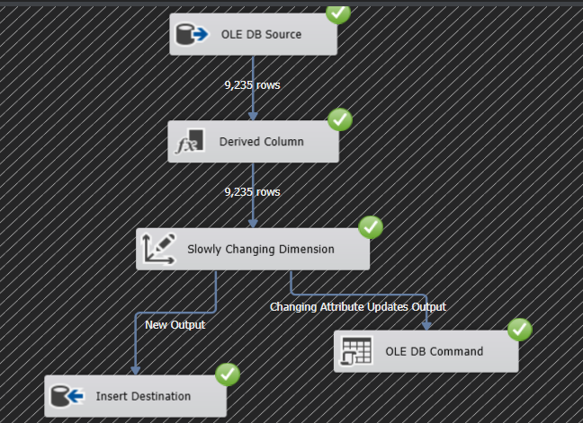
Author_Dim

Slide 10
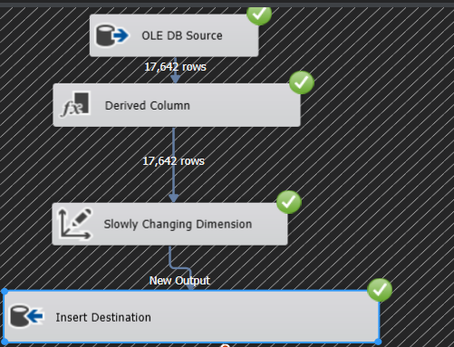
Author-Book_Dim

Slide 11
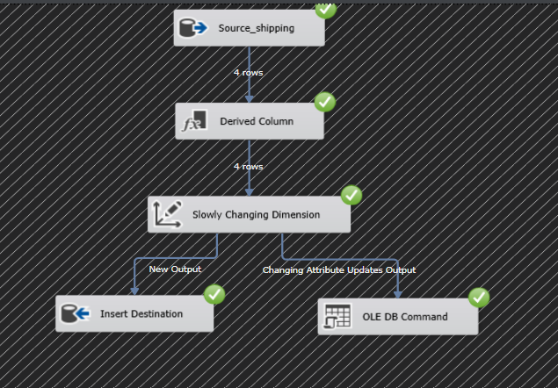
Shipping Method_Dim

Slide 12
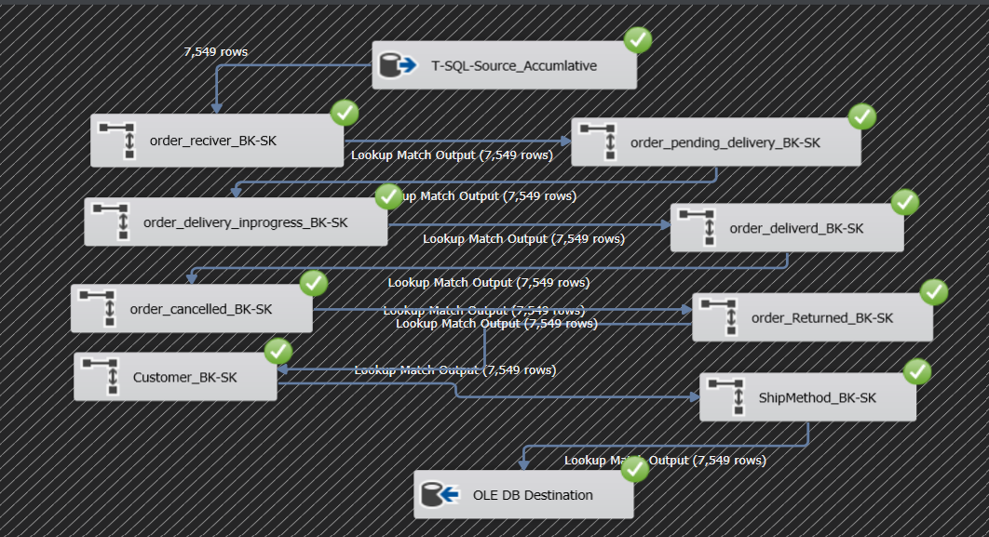
Accunlated_Fact

Slide 13
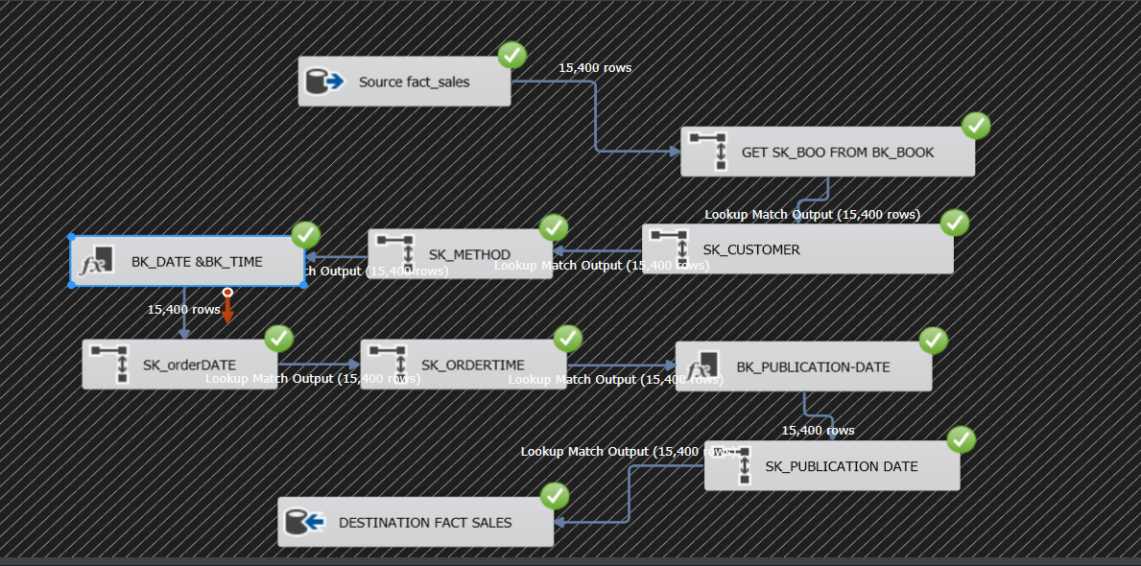
Tranasactions(sales)_Fact

Slide 14
SQL Server Analysis Services (SSAS)
Analysis Process

Slide 15
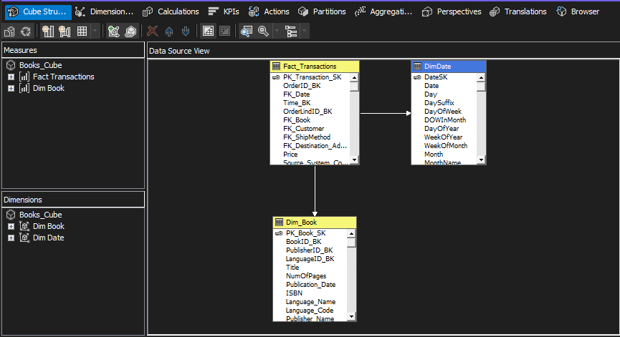
Book Cube

Slide 16
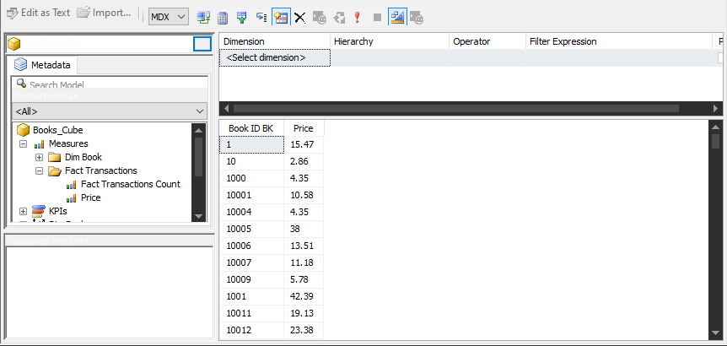
A Book Analysis Using SSAS

Slide 17
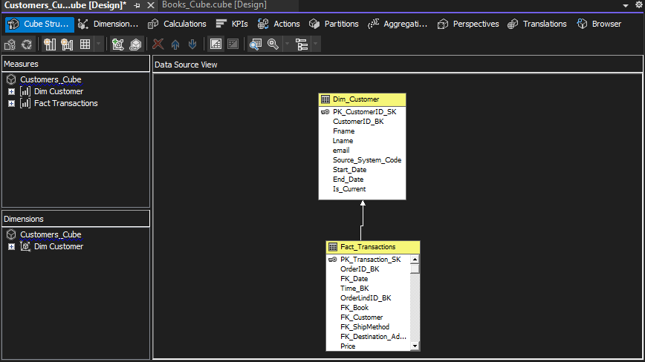
Customer Cube

Slide 18
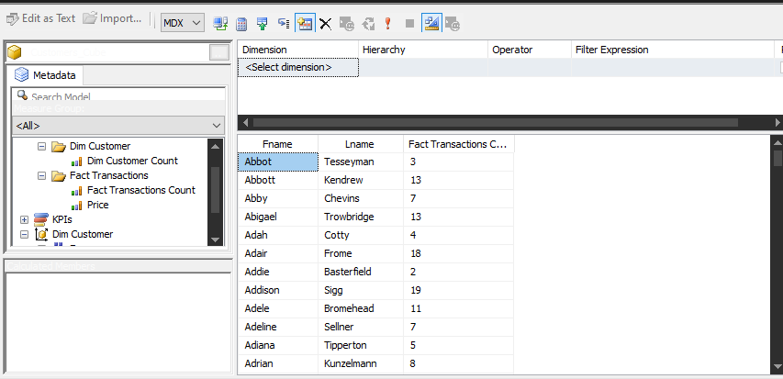
A Customer Analysis using SSAS

